Slide 1
Chapter 13
Enhanced Entity-Relationship Modeling
Pearson Education © 2009

Slide 2
Chapter 13 - Objectives
Limitations of basic concepts of the ER model and requirements to represent more complex applications using additional data modeling concepts.
Most useful additional data modeling concept of Enhanced ER (EER) model is called specialization/generalization.
A diagrammatic technique for displaying specialization/generalization in an EER diagram using UML.
Pearson Education © 2009

Slide 3
Enhanced Entity-Relationship Model
Since 1980s there has been an increase in emergence of new database applications with more demanding requirements.
Basic concepts of ER modeling are not sufficient to represent requirements of newer, more complex applications.
Response is development of additional ‘semantic’ modeling concepts.
Pearson Education © 2009

Slide 4
The Enhanced Entity-Relationship Model
Semantic concepts are incorporated into the original ER model and called the Enhanced Entity-Relationship (EER) model.
Examples of additional concept of EER model is called specialization / generalization.
Pearson Education © 2009

Slide 5
Specialization / Generalization
Superclass
An entity type that includes one or more distinct subgroupings of its occurrences.
Subclass
A distinct subgrouping of occurrences of an entity type.
Pearson Education © 2009

Slide 6
Specialization / Generalization
Superclass/subclass relationship is one-to-one (1:1).
Superclass may contain overlapping or distinct subclasses.
Not all members of a superclass need be a member of a subclass.
Pearson Education © 2009

Slide 7
Specialization / Generalization
Attribute Inheritance
An entity in a subclass represents same ‘real world’ object as in superclass, and may possess subclass-specific attributes, as well as those associated with the superclass.
Pearson Education © 2009

Slide 8
Specialization / Generalization
Specialization
Process of maximizing differences between members of an entity by identifying their distinguishing characteristics.
Generalization
Process of minimizing differences between entities by identifying their common characteristics.
Pearson Education © 2009

Slide 9
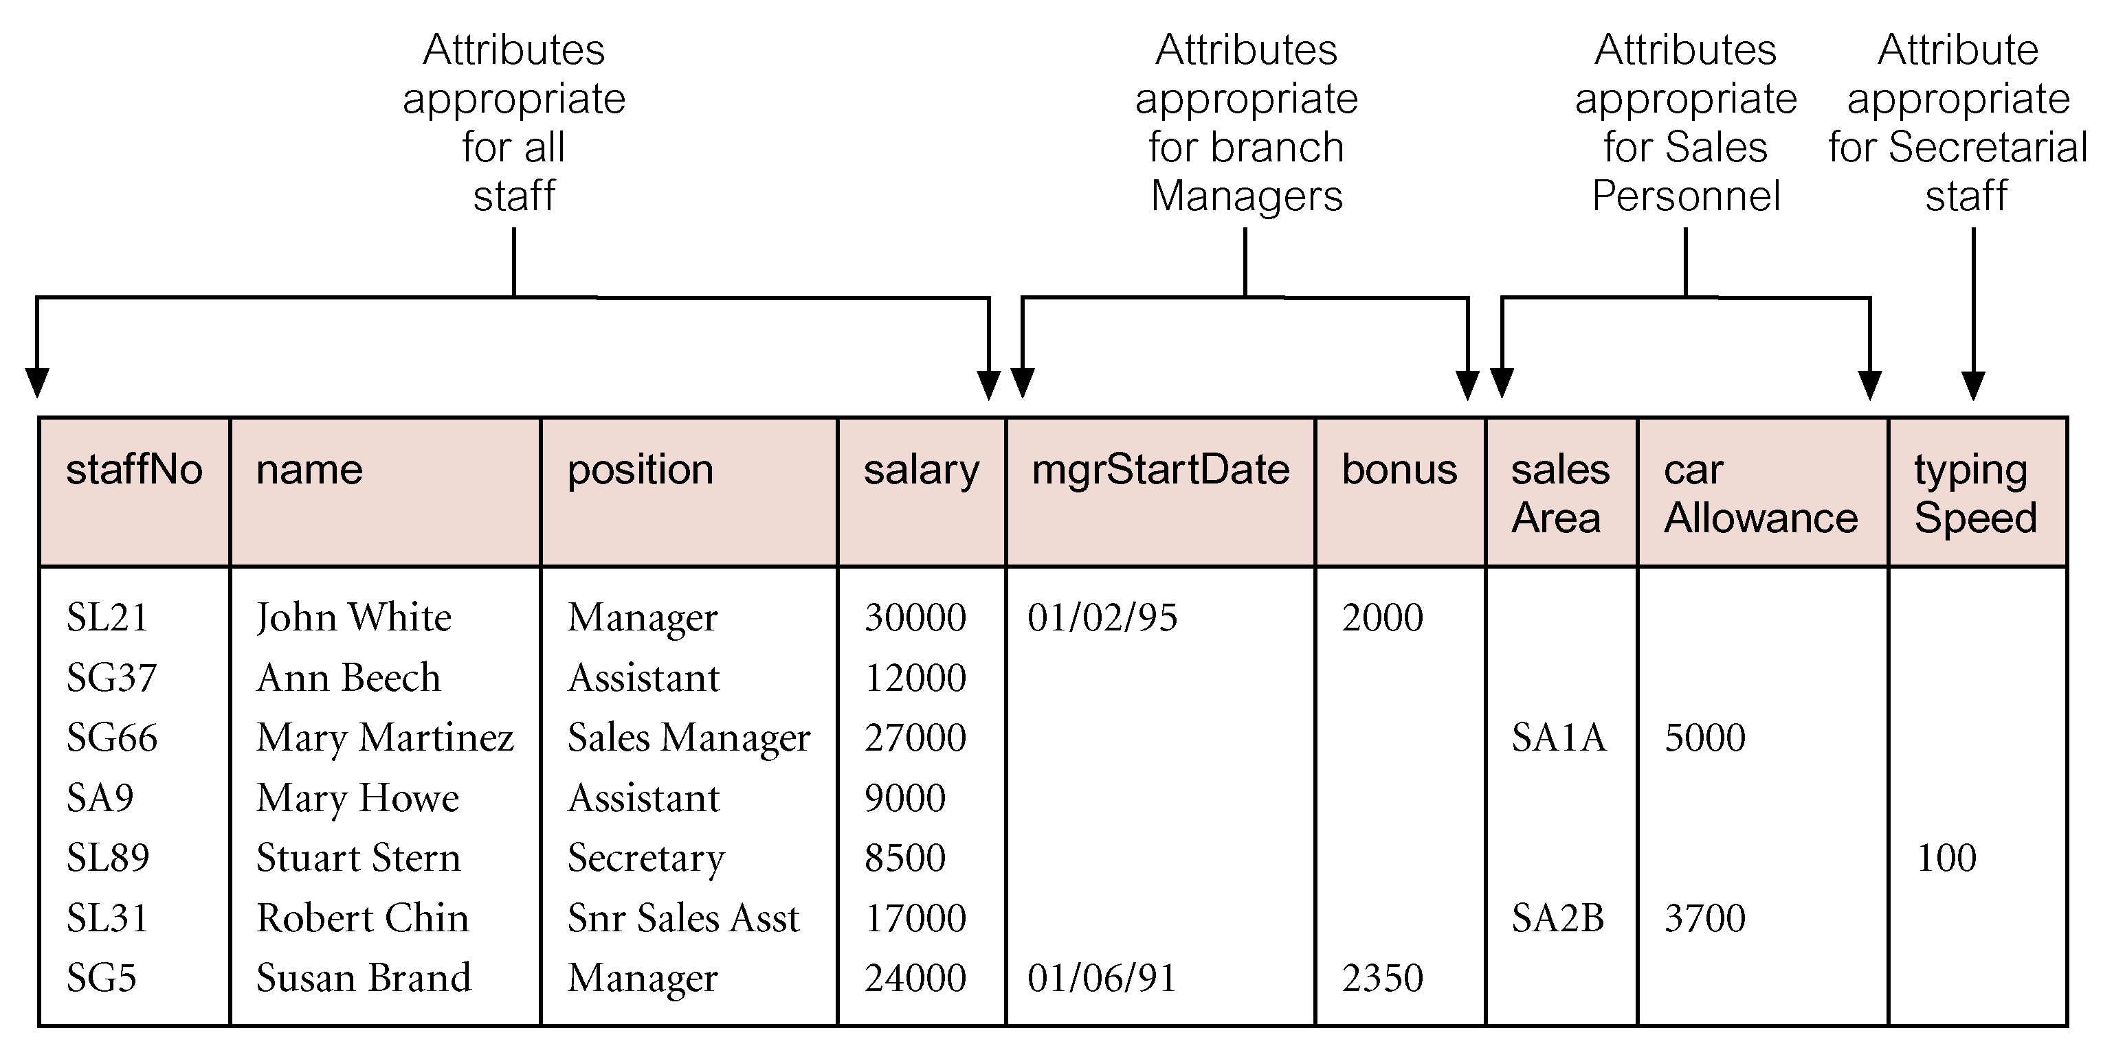
AllStaff relation holding details of all staff
Pearson Education © 2009

Slide 10
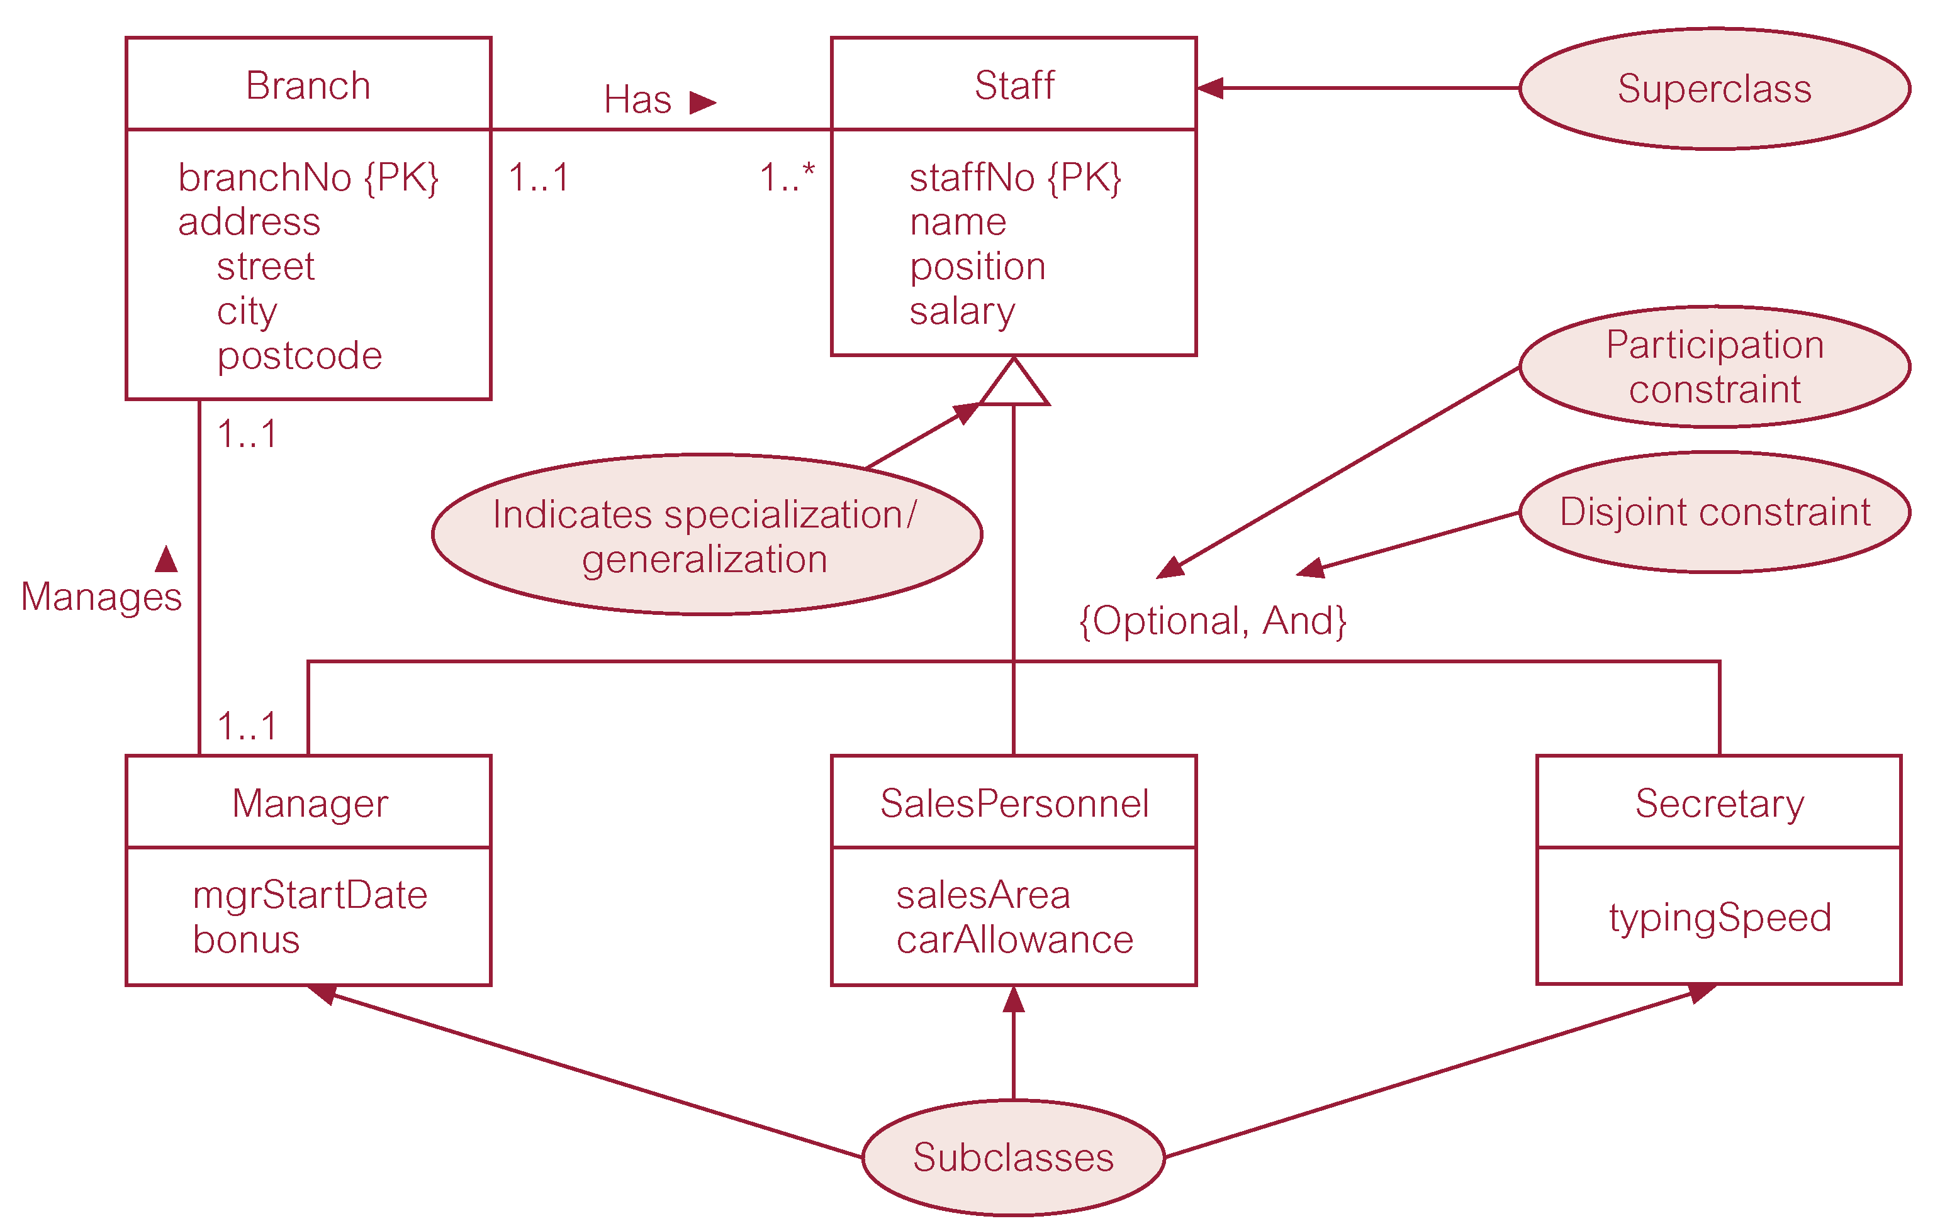
Specialization/generalization of Staff entity into subclasses representing job roles
Pearson Education © 2009

Slide 11
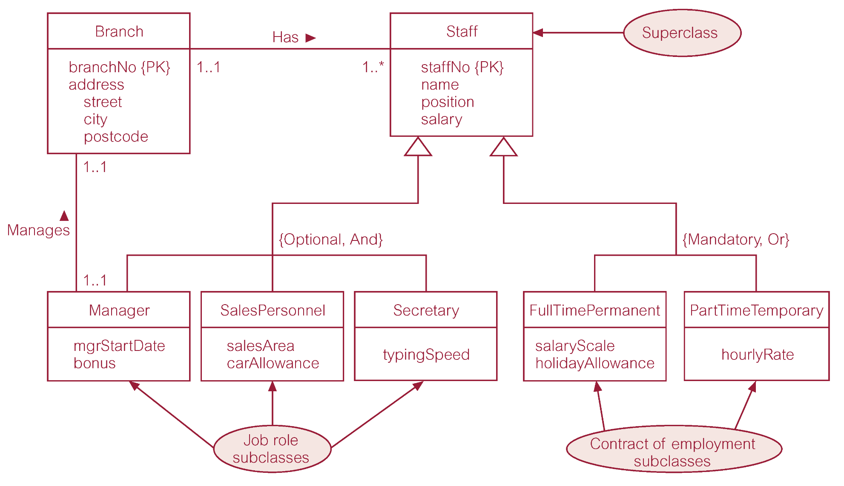
Specialization/generalization of Staff entity into job roles and contracts of employment
Pearson Education © 2009

Slide 12
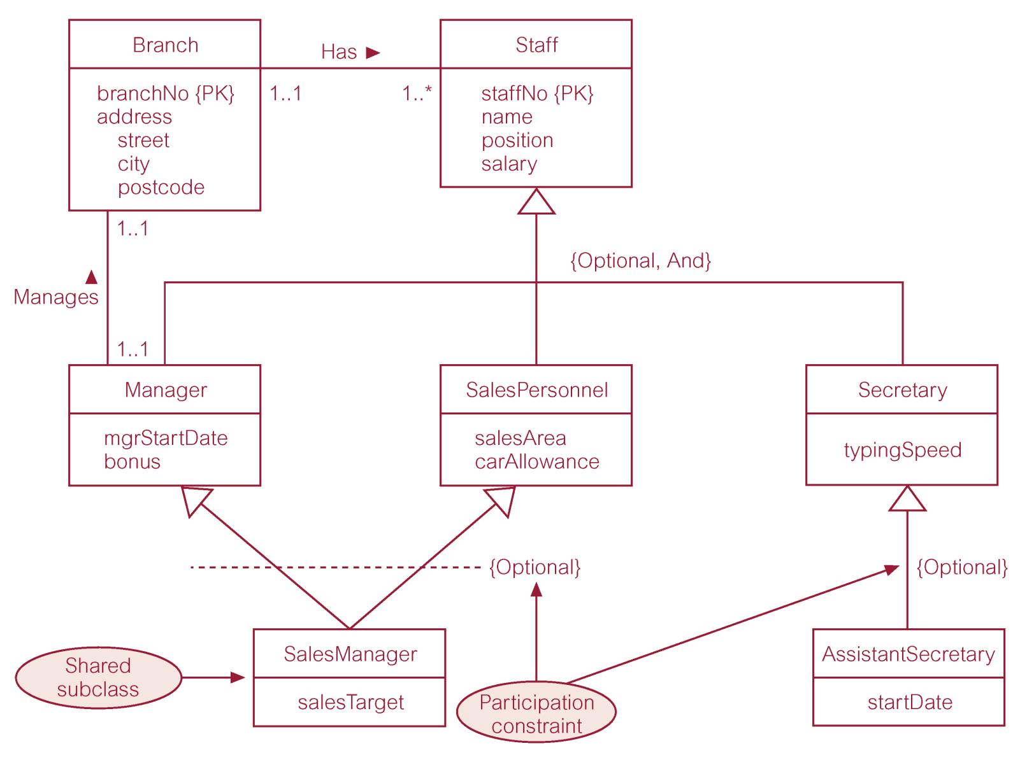
EER diagram with shared subclass and subclass with its own subclass
Pearson Education © 2009

Slide 13
Constraints on Specialization / Generalization
Two constraints that may apply to a specialization/generalization:
participation constraints
disjoint constraints.
Participation constraint
Determines whether every member in superclass must participate as a member of a subclass.
May be mandatory or optional.
Pearson Education © 2009

Slide 14
Constraints on Specialization / Generalization
Disjoint constraint
Describes relationship between members of the subclasses and indicates whether member of a superclass can be a member of one, or more than one, subclass.
May be disjoint or nondisjoint.
Pearson Education © 2009

Slide 15
Constraints on Specialization / Generalization
There are four categories of constraints of specialization and generalization:
mandatory and disjoint
optional and disjoint
mandatory and nondisjoint
optional and nondisjoint.
Pearson Education © 2009

Slide 16
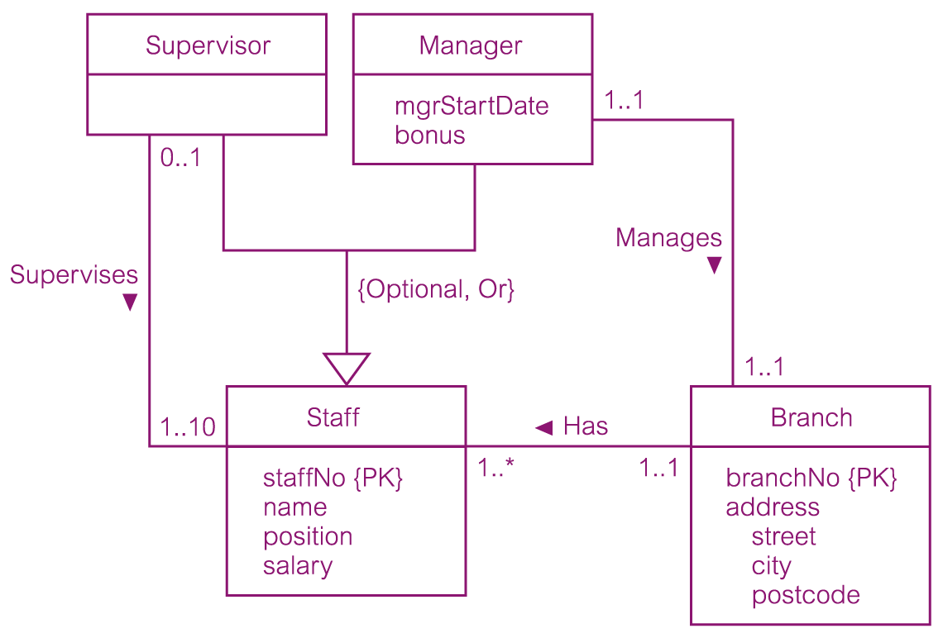
DreamHome worked example - Staff Superclass with Supervisor and Manager subclasses
Pearson Education © 2009

Slide 17
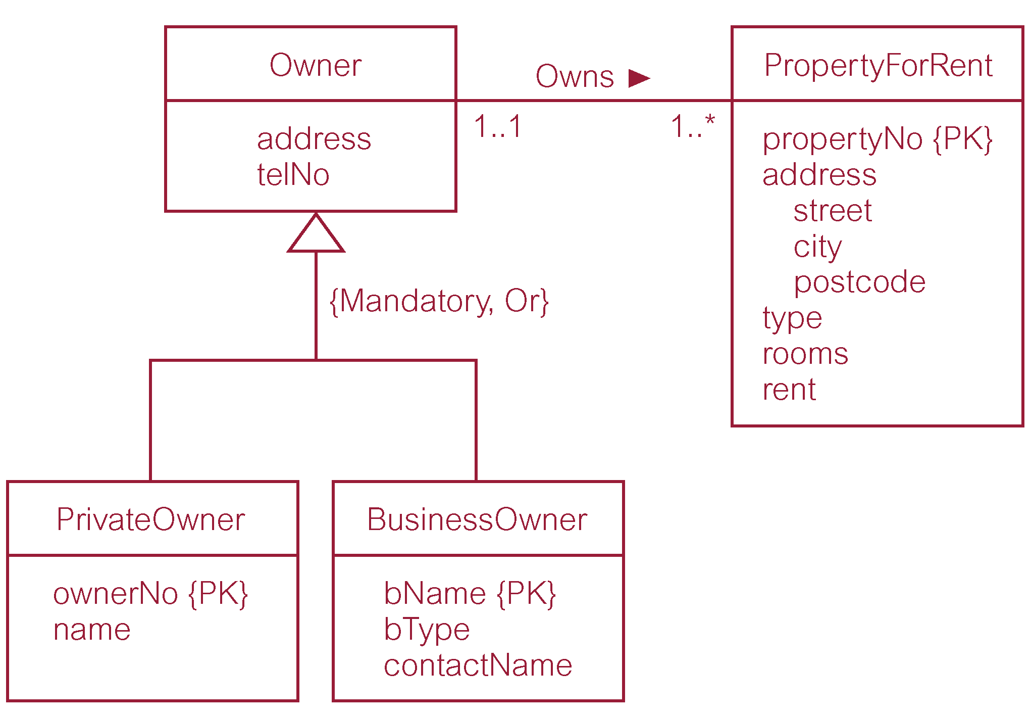
DreamHome worked example - Owner Superclass with PrivateOwner and BusinessOwner subclasses
Pearson Education © 2009

Slide 18
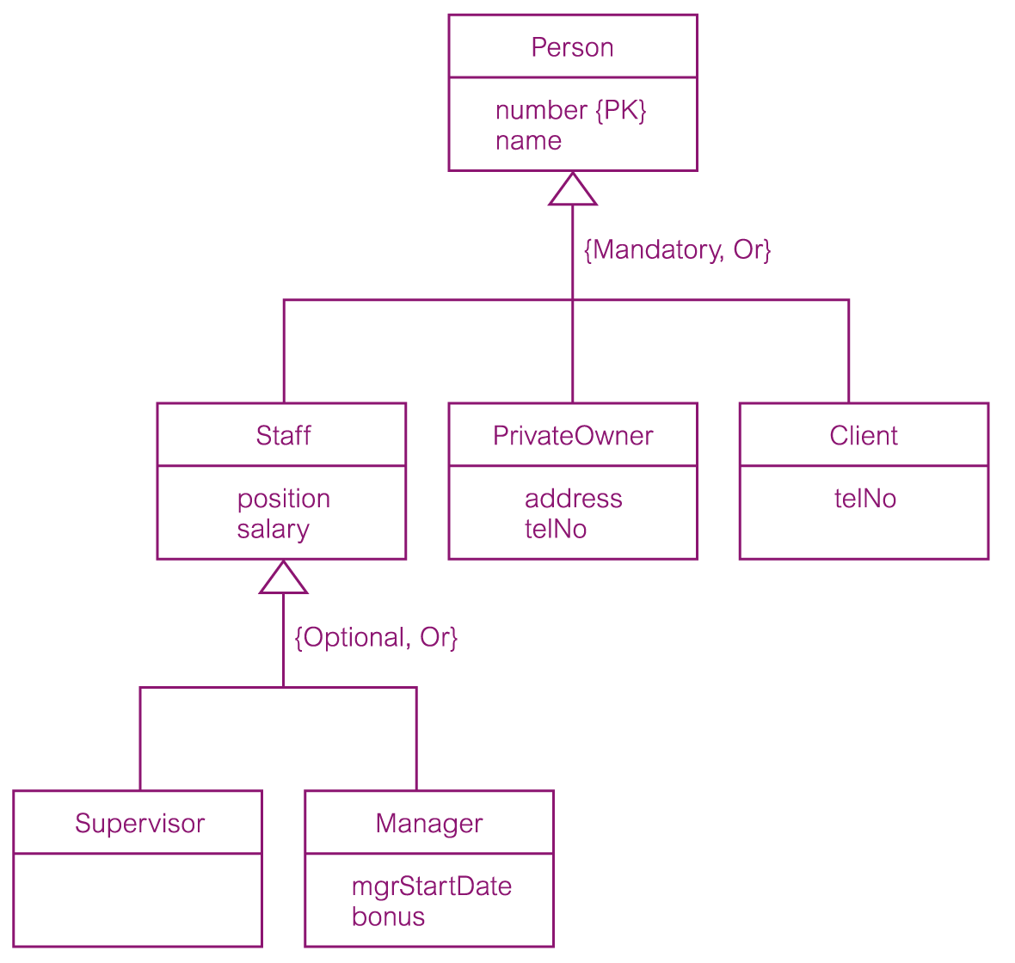
DreamHome worked example - Person superclass with Staff, PrivateOwner, and Client subclasses
Pearson Education © 2009

